Slide 1
ARITHMETIC 4 ---
Writing numbers
Add a brief explanation of the presentation’s purpose

Slide 2
Numbers are universal IDEAS which invokes our spiritual activity to understand them.
On the Soroban the numbers are visible but not written.
Writing brings numbers into the physical world, and supports our memory for large numbers or complex calculations and helps when we wish to communicate with another person - or with a computer/calculator!
In earlier cultural ages, every language had its own set of numerals, often so different as to be unrecognisable.
The Hindu-Arabic numeric system, (that includes zero, 0), which is used worldwide today, was introduced only in the 10th century AD, which is relatively recent historically.

Slide 3
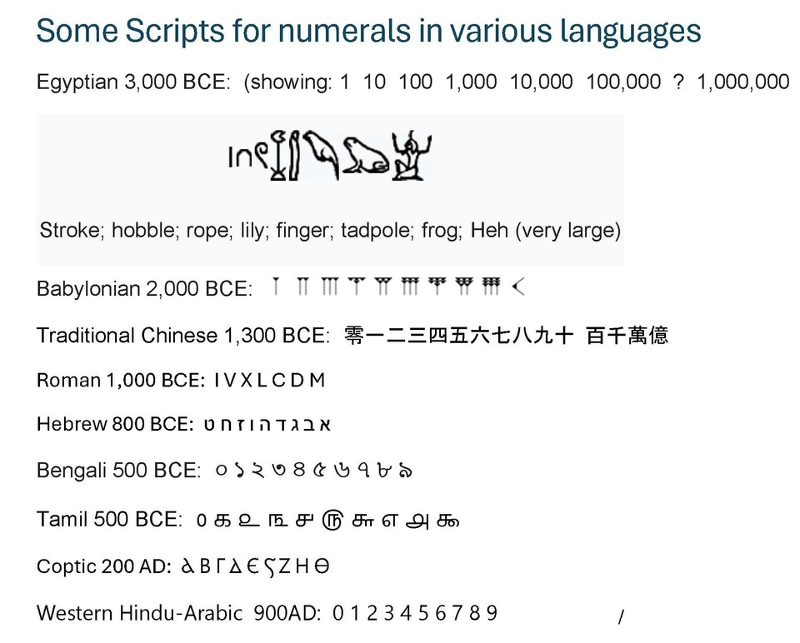

Slide 4
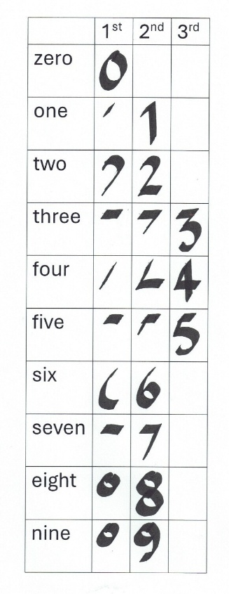
Writing modern numbers
A criterion for symbols is that they must be easy and quick to write, with as few strokes as possible - this table shows that is true for our modern symbols:

Slide 5
Distinctiveness
On the other hand, they are best being quite distinct from each other, and not easily confused with one another or letters of the alphabet.
So, strangely 6 and 9 are very similar - one being a rotation of the other (For people with dyslexia, that can be a problem.).
As well as that, when we compare scripts for the numerals with those for the alphabet, we get a close similarity between the vowel, O, and the numeral for zero, 0; and between the vowel, I, and the numeral for one, 1, and the lower case l (L).
These five symbols as seen in 6 computer fonts

Slide 6
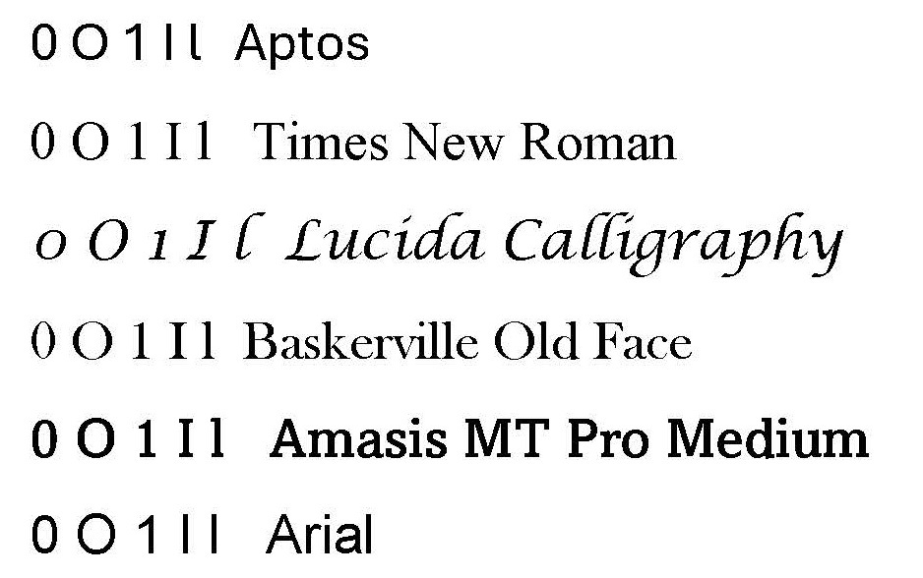
Font confusion: o I 0 1 l

Slide 7
polarity
There is a polarity between the circular O and the straight I, which is used in the On/Off symbol Φ
where O = Off and I = On. The binary counting system - the basis of computer programming - simply uses just one, I and zero, 0.
Somewhat related is the high degree of symmetry of the Roman capital letters (uncial [=written in the same-sized box] majascules).

Slide 8
