Slide 1
Arithmetic as an entry into
Mathematics
Presented by Dr. Robin Bacchus

Slide 2
Arithmetic can be seen as an entry into Mathematics
Mathematics is the science and study of quality, structure, space, and change by seeking out patterns and formulating new conjectures, from the Greek ‘manthanein’ to learn.
One could say: Mathematics is an intelligent human response to the discovery of the wonders of existence.

Slide 3
At first, as a child, the world, over which the sun shines, appears to us as an outer Oneness.
We next differentiate PARTS of existence from their background, so they become separate. This requires discrimination (a process called analysis).
Once the parts are separated in our mind, we can count them, acknowledge them.

Slide 4
Arithmetic is the ‘art of counting’ from the Greek ‘arithmos’ number.
Numbers are not things – they are ‘ideas’. So Arithmetic is, essentially, a thinking activity – a ‘spiritual’ science. Most children encounter this early in their schooling.

Slide 5
The three soul forces of willing, feeling and thinking are involved

Slide 6
Willing
Willing: When counting objects of a similar nature, say apples (or in a classroom, maybe, ‘beanbags’) in a basket. One first perceives a unity, a ‘basket’.
On analysis – an important activity for a school child – the basket is seen to contain many bean-bags. How many? Let’s count! Now the activity: grasp a bean-bag … put it on the table, and say “one” … take a second bean-bag … put on the table beside the first one, and say “two” … and so on until no bean-bags are left in the basket and a new pile has been formed on the table (synthesis).
The will activities incurred have been ‘grasp’, ‘put’, ‘say’.

Slide 7
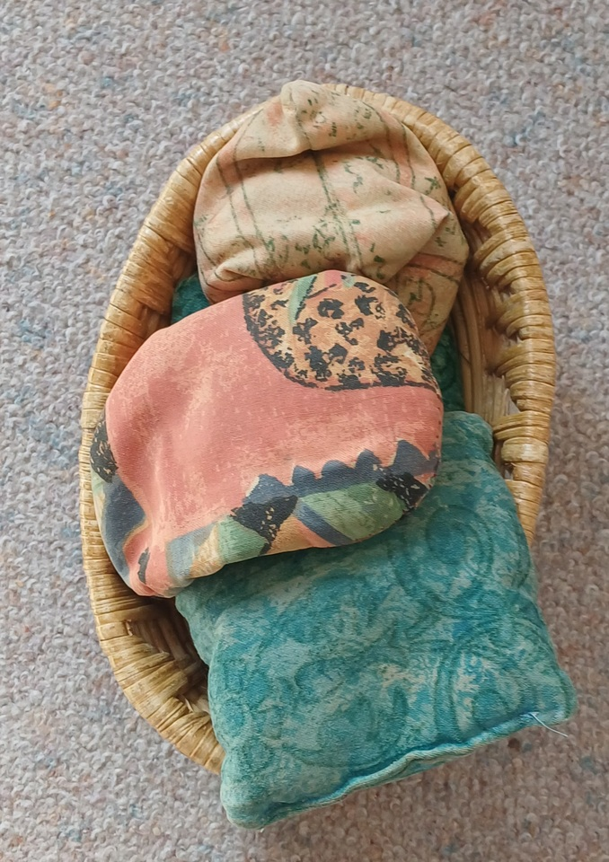
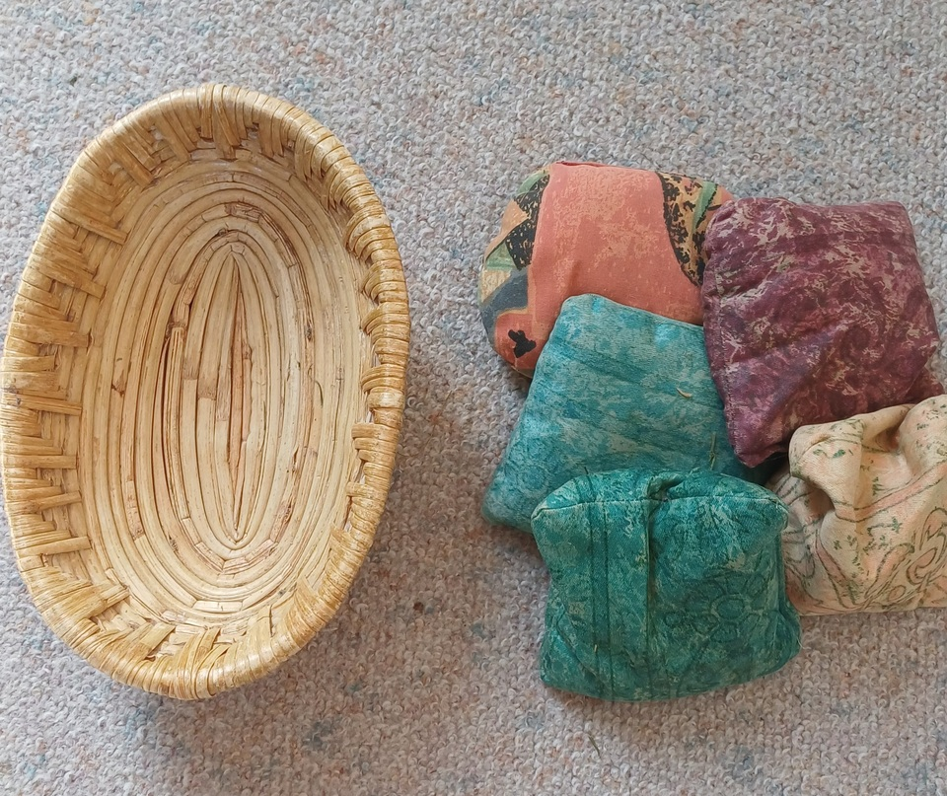
How many bean-bags? Let’s Count - take them out one by one:
( Full ) >>>1>>>2>>>3>>>4>>>5>>> (Empty)

Slide 8
Feeling
Feeling in this situation is connected with the relationships between ‘things’ or ‘beings’, namely between the ‘numbers’ in the sequence which we learn by rote (like poetry) for counting, ‘one, two, three, four, five …’
We get to know that ‘one’ comes first; that ‘four’ comes after ‘three’ but before ‘five’.
Every language, a child of feeling, has its own set of Counting Numbers. We know the numbers ‘by heart’.

Slide 9
Thinking
Thinking is a more reflective process. Here it is concerned with the essential character of each number.
‘One’ is all alone, I, it is lonely, so it needs to be strong and resolute. In one sense, the whole world is ‘one’.
‘Two’ has a partner – they can stand side by side: II, as a pair, wings on a bird or butterfly. Left and right hand (eye, ear, foot, etc.). But they can also form a polarity, such as father-mother; day-night; sun-moon; up-down; forwards-backwards; window-wall; sky-earth. Can you think of more?
‘Three’ can be more complex. When three stand side by side, III, one is in the middle, with the ends being a polarity: mother-child-father; left-centre-right, Or three, 3, can form a tripod of equals, as the three legs of a stool. They may form a sequence: dawn-day-dusk.

Slide 10
‘Four’ is the number of legs that cat, dog, cow and chair have. Wheels on a car. Directions: north, east, south, west. Earth, water, air, fire.
Five
Six
Seven
And so on with larger numbers – children love discovering ‘numbers’ inherent or hidden in their environment.

Slide 11
Many things connected with maths can be seen in the light of the three soul forces engaged in the early years:

Slide 12
Will: creating and working with patterns and form; counting objects – determining quantity. Writing numbers; number operations [adding, subtracting, multiplying, dividing, etc.]; calculations. Involving action, change.
Feeling: rhythm and rhyme, counting sequence, relationships [equations: equals =, larger >, smaller < than]; ordinal numbers – rank, position [first, second, etc.]. Involving judgment.
Thinking: the essence of number, symbols, concepts, cognition; qualitative aspects. Involving imagination, picturing.

Slide 13
With the names for numbers used in various European languages, it is interesting to see their similarity;
the interchangeability of T and D and Z ,
or of S and H when spoken.

Slide 14
# | English | Latin | French | German | Spanish | Greek
1 | One | Unus | Un | Eins | Uno | Ena (Ένα)
2 | Two | Duo | Deux | Zwei | Dos | Dyo (Δύο)
3 | Three | Tres | Trois | Drei | Tres | Tria (Τρία)
4 | Four | Quattuor | Quatre | Vier | Cuatro | Tessera (Τέσσερα)
5 | Five | Quinque | Cinq | Fünf | Cinco | Pente (Πέντε)
6 | Six | Sex | Six | Sechs | Seis | Hexa (Έξι)
7 | Seven | Septem | Sept | Sieben | Siete | Hepta (Επτά)
8 | Eight | Octo | Huit | Acht | Ocho | Octo (Οκτώ)
9 | Nine | Novem | Neuf | Neun | Nueve | Ennea (Εννέα)
10 | Ten | Decem | Dix | Zehn | Diez | Deca (Δέκα)

Slide 15
They are all based on ten - the number of digits on our two hands. Also, 10=1+2+3+4 (sum of the first four numbers). It is interesting that 7 (a prime number) is used in counting time: 7 days in a week - based on the 7 heavenly lights that move across the firmament of the stars [Sun, Moon, Mercury, Venus, Mars. Jupiter, Saturn.] A human lifetime is loosely divided into 7-year epochs until the age of 63.

Slide 16
There are 13 weeks in a season and 4 seasons in a year, but then there are 12 months in a year. A dozen [12] is used in packing things, like eggs. Day and night each have 12 hours! 12 is an abundant number as it has many [4] factors: 12=2x6=3x4, while ten is a 'poor' number - it has only two: 10=2x5.
The ancient Sumerian civilisation had a base of 60. The legacy of that is 1 hour = 60 minutes [minute means small]; and 1 minute = 60 seconds [ the hour was 'first']
Anyway, ten has been universally adopted by the modern world as the base for counting. 100=10x10; 1,000 = 10x10x10 and so on.

Slide 17
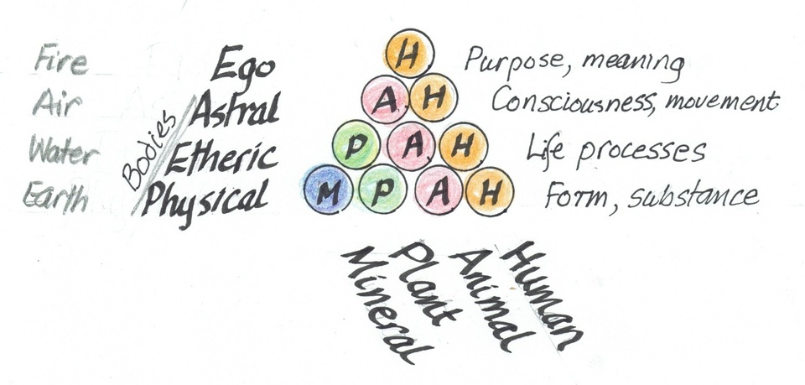
A more esoteric reason may be that ten has been considered of the Earth because of the four natural realms Mineral. Plant, Animal, Human as shown in this diagram where 1+2+3+4=10

Slide 18
When doing Arithmetic, writing the full name is rather laborious; we need a quicker system of making marks, or in some other way to keep track, to represent the number. Historically, it has been quite a journey to arrive at the symbols used so widely today. Let's explore:
What patterns can be made out of each number of small items - in a classroom a selection of florist's coloured glass pebbles. Here are some - note the relation between Even and Odd - what do you see?

Slide 19
