Slide 1
Math 3 Pebble Patterns
Pebbles = Gems = Dragon’s Tears – 2
Scattered, Gather them, Patterns, Halving, Doubling – 3
Squares, Even numbers, A special square – 8
How many? Quantity? Count the number – 12
Number Recognition cards – 13

Slide 2
Pebbles = Gems = Dragon’s Tears
A story:
“There was once an old man [gnome, dwarf, troll, …] who worked in the mountains digging and collecting gems which he put into his basket to bring home at the end of the day.
The most beautiful gems were shaped like small round coloured pebbles – they were dragon’s tears, shed by the dragons of the mountains who cried and shed large tears when they heard of the unkind and cruel things that human beings did to each other. When the tears hit the ground they solidified into these gems.
As evening came he trundled off home and on the way he came to a stream through which he waded every day.
But this day the stones in the stream were slimy and slippery and he slipped and fell, scattering the gems in the stream.

Slide 3
Scattered
‘O help! children come and help me pick up these gems from the bottom of the stream.
You will have to take off your socks and shoes and wade into the stream and pick up my gems, feeling with your toes.
You will have to close your eyes because it is dark.’

Slide 4
Gather them
“Pick up scattered ‘gems’ between your toes; make a pile on the carpet in front of you.
Count out loud together in sequence.
Who has more than twenty five?
How many more? Put your extra ones back in the basket.
Now, who needs more to make 25? How many?
‘A’ can you please count out from the basket what ‘B’ needs.”

Slide 5
Patterns
“Take six from your main pile and make a little pile just in front of you.
How many are left behind? Who needs more?”
“Make a pattern with your six. Can you say what you have done?”
Explore the various possibilities. Praise the innovative.
Help them describe in words (concepts) what they have done.

Slide 6
Halving
”Now place your six gens carefully into a circle.
From each pair of gems take away every second one. How many are there now? [3]
Can you do that again? [no] Why not – what happens?”
Explore odd and even numbers.

Slide 7
Doubling
“Now place your six gems carefully into a circle again.
A little larger, with the gaps even.
Now put a marble from your main pile into each gap.
How many are there now in the circle? [12]”

Slide 8
Square
“Can you now make them into a square?
How many along each side? [4]
How many do you need to fill it in? [4]
Fill it in, then.
Now how many are there? [16]”

Slide 9
Even numbers
“Now place your 16 marbles carefully into a circle.
Take away every second marble.
How many are there now? [8]
Can you do that again? [yes, 4]
Again? [2]
And again? [1]
So we can see that 16 is a very even number.”

Slide 10
Bigger Squares
“Make your 16 back into a square.
Use your other marbles to make a smaller square [3x3].
How is it made up?”
“Now use the smaller square to make the larger square even bigger.
What has happened?” [The two small squares exactly make one larger square.]

Slide 11
A special square
o | o | o | o | x
o | o | o | o | x
o | o | o | o | x
o | o | o | o | x
x | x | x | x | x
“There is a special magic about this, that was discovered long ago by a wise man called Pythagoras, which you will learn about when you are older.”
毕达哥拉斯

Slide 12
How many? Number recognition…..
Make small placards with a single group of symbols on it. Hold up one at a time – in response children visually recognise the associated number and put up their hand(s) with same number of fingers showing.
Next get the children to make their own set of placards with a numeral from 1 to 9 written on it: 1 2 3 4 5 6 7 8 9
This time they select the correct placard and display that each time you hold up a group of symbols.
The following placards – that could be used – have a variety of symbols, words, numerals from west (English) and east (Mandarin) on one side and the western Arabic numerals large on the reverse side.

Slide 13
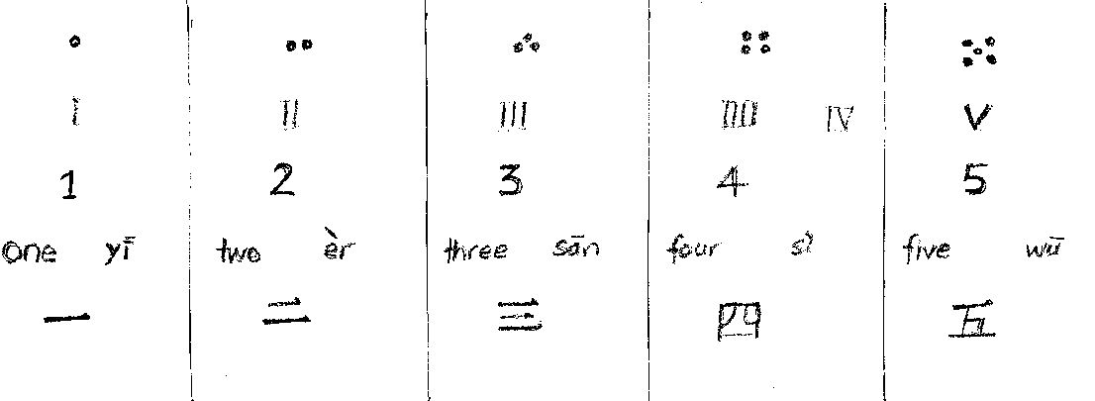
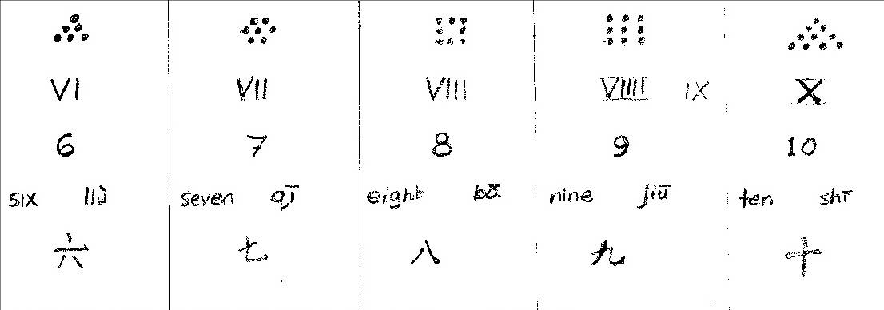

Slide 14
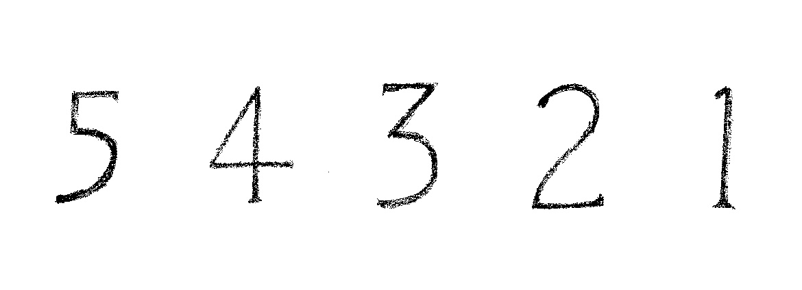
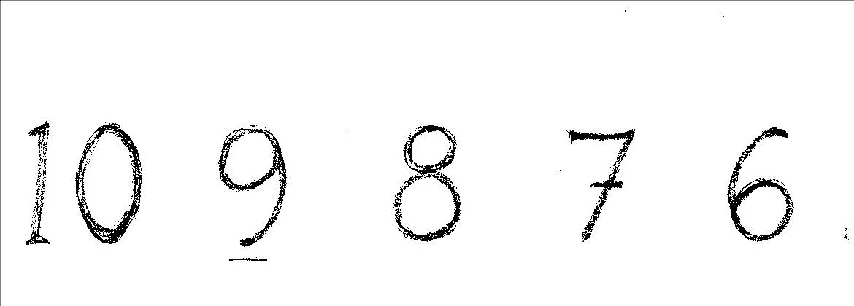

Slide 15
Placards for recognition
The following slides show a selection of placards that could be shown to the children for them to visually recognise the number of items shown;
Be creative – invent your own!
Mix them up…
Have some that have several possible answers.
Don’t tell anyone that they are wrong, but ask them how they arrived at their answer/response. Be open! You may learn something.

Slide 16
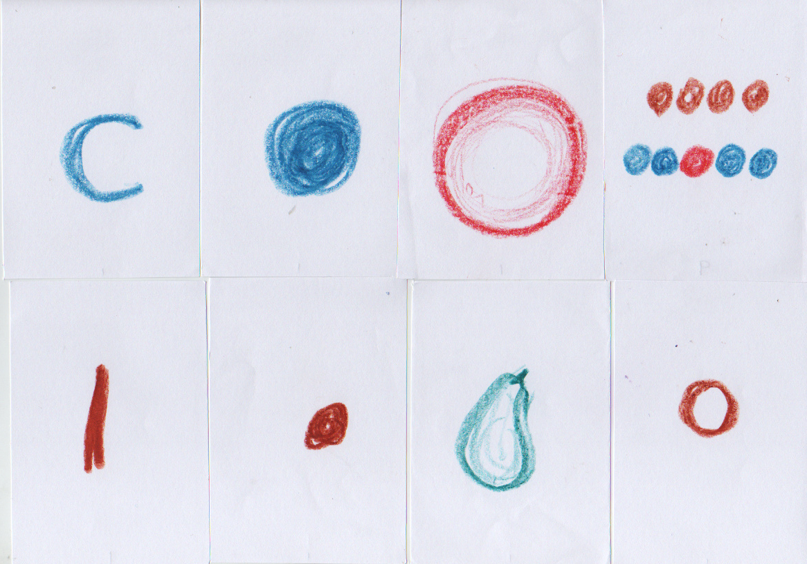
How many? Quantity? Count the number…..
Make small placards with a single group of symbols on it. Hold up one at a time – in response children put up the same number of fingers.
Next get the children to make their own set of placards with a numeral from 1 to 9 written on it: 1 2 3 4 5 6 7 8 9
They select the correct card and display it each time you hold up a group of symbols.
Note that for the fourth one several answers are possible: 2 rows; 3 colours; 4 groups; 9 dots

Slide 17
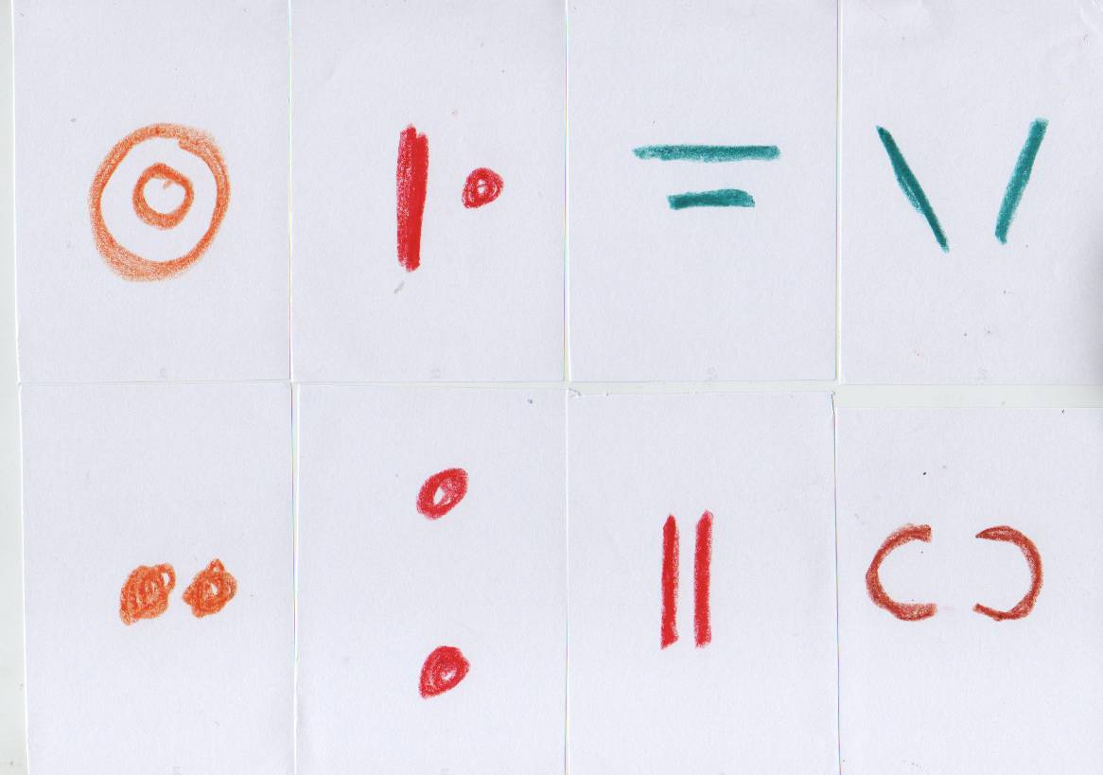

Slide 18
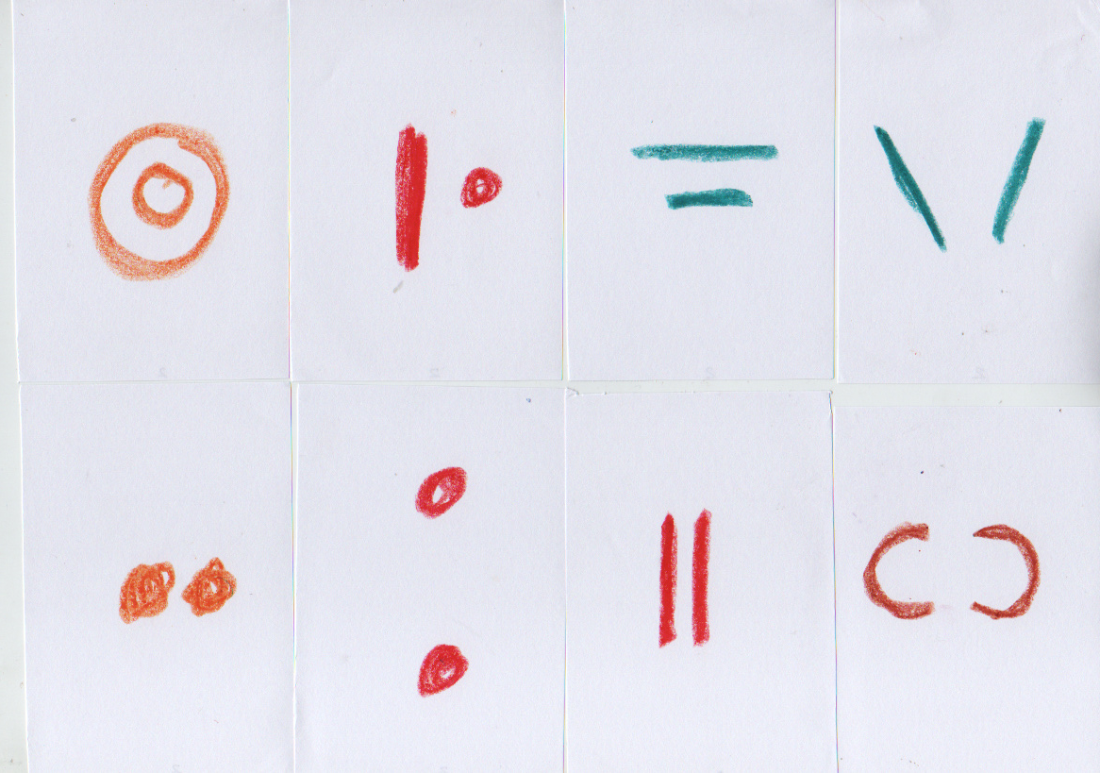

Slide 19
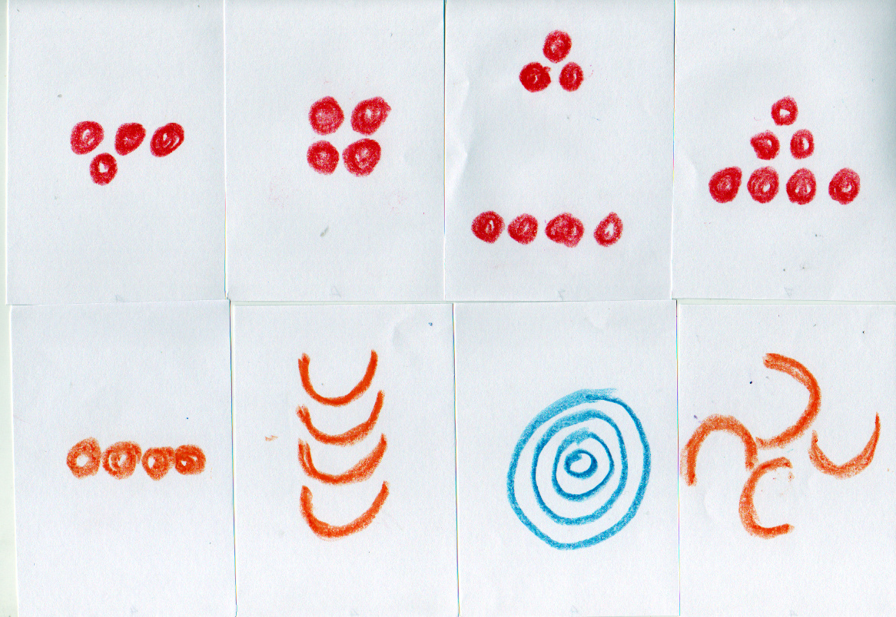

Slide 20
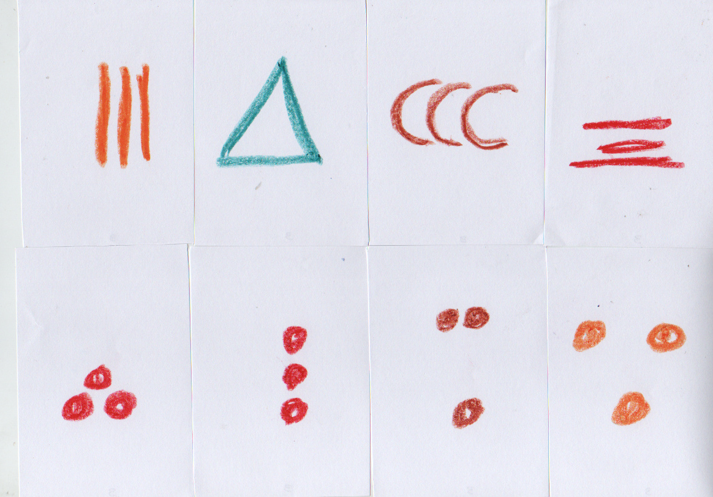

Slide 21
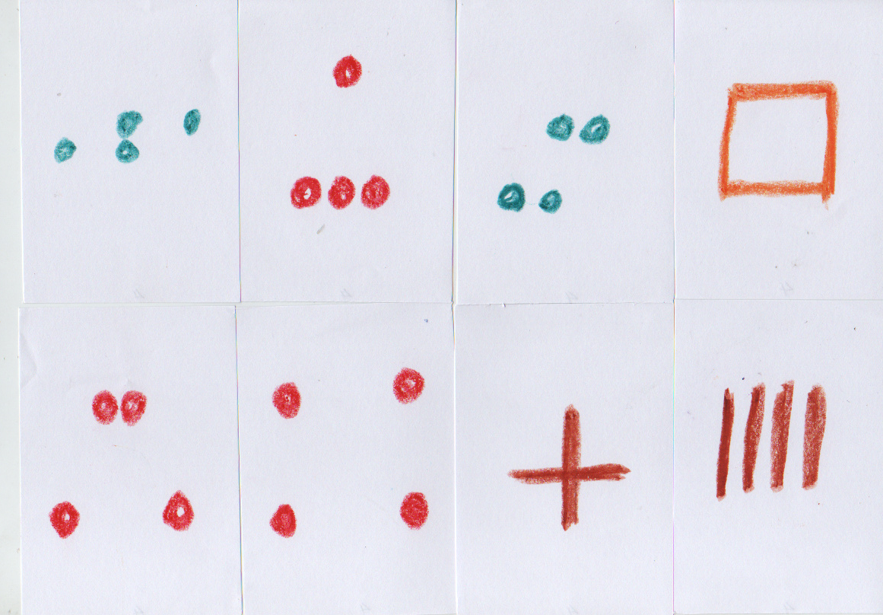

Slide 22
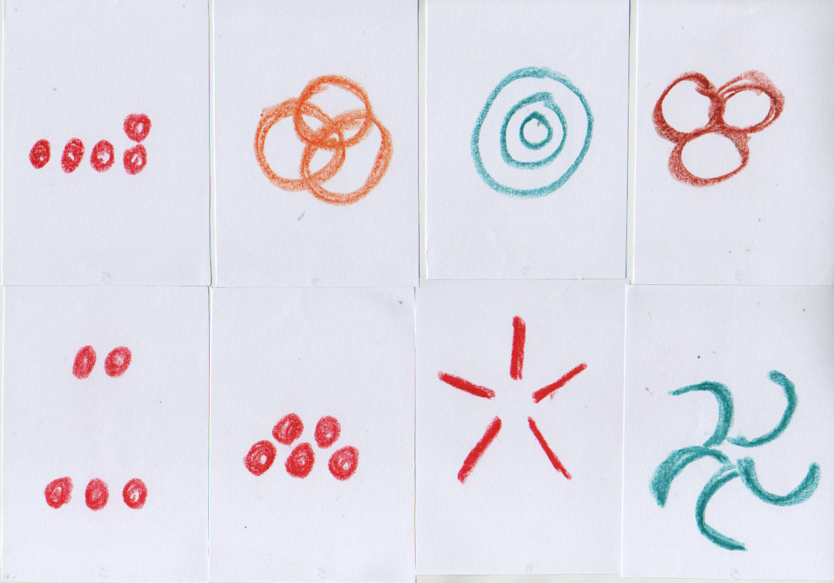

Slide 23
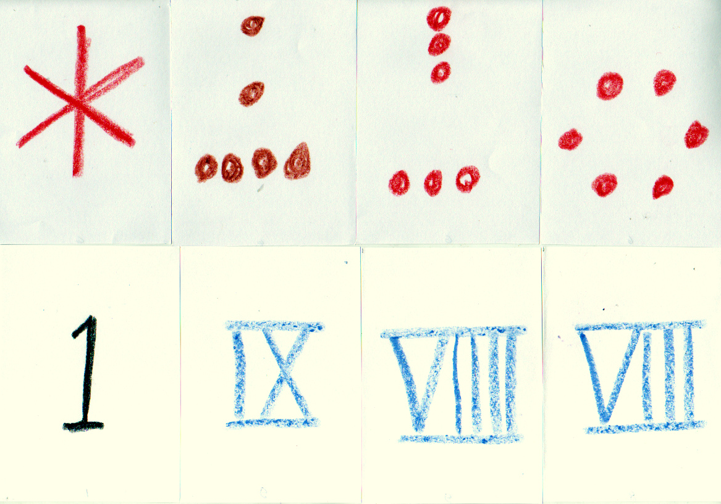

Slide 24
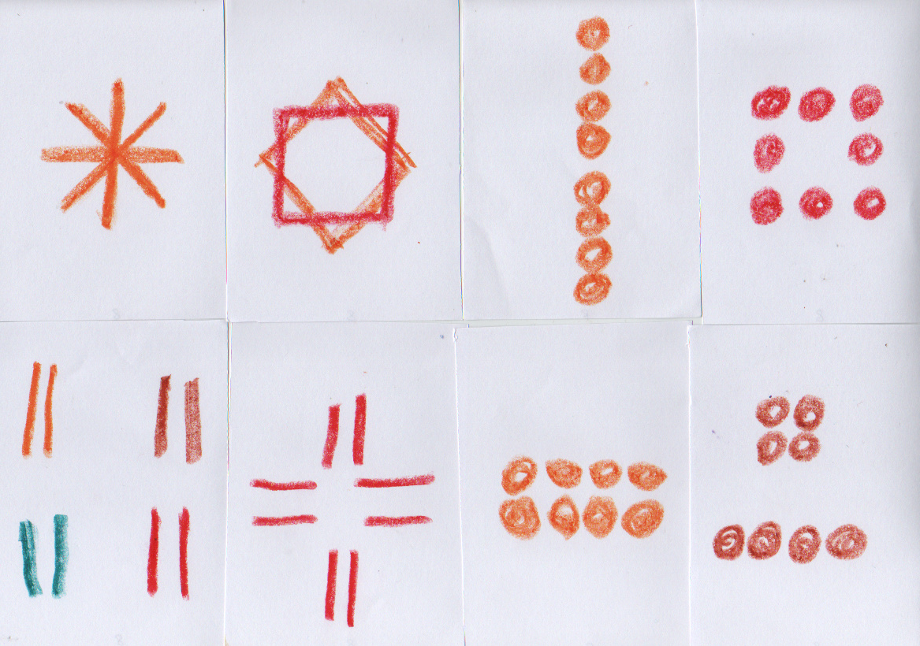

Slide 25
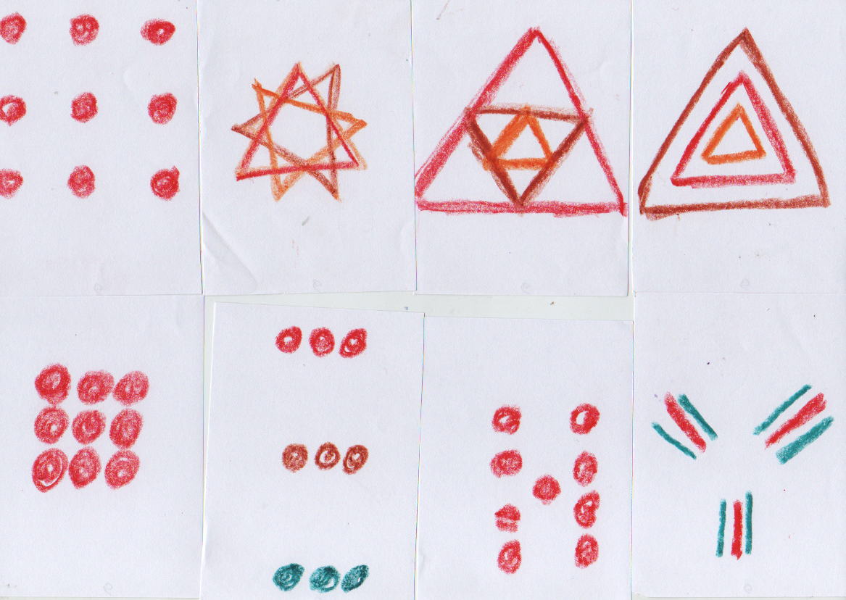

Slide 26
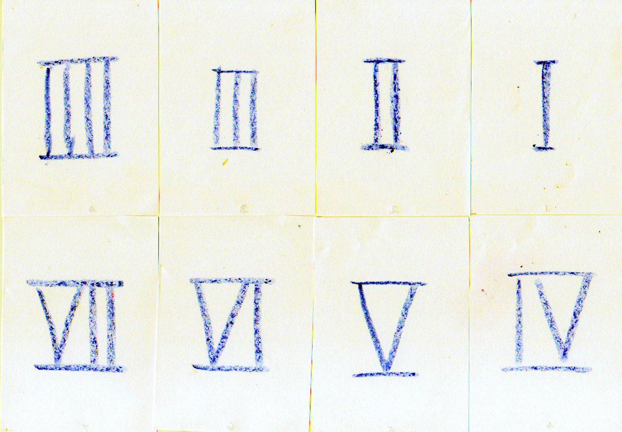

Slide 27
